Slide 1
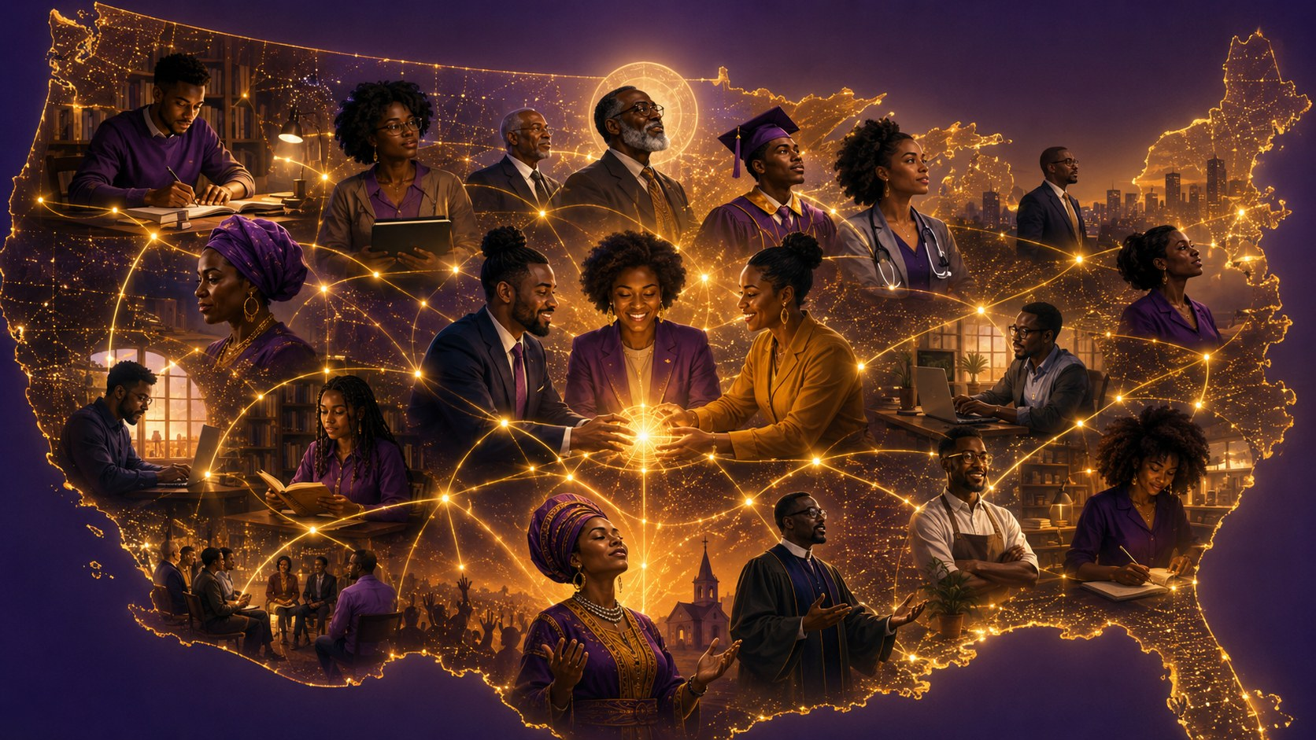
We are stronger together than apart.
NATIONAL HBCU ALUMNI ASSOCIATIONS FOUNDATION
Continuing
the Legacy
From alumni pride to collective power
Dr. Evelyn Bethune
Managing Director, Dr. Mary McLeod Bethune Family Legacy Foundation, Inc.
Graduate of Bethune-Cookman College (University), Class of 1979
drevelyn@greatnessdna.com
Continuing the Legacy · We Are Stronger Together Than Apart
Notes:
Open with warmth and energy. Invite them to put their HBCU in the chat. Let the chat fill. Then say: This is not a roll call. This is an asset map.

Slide 2
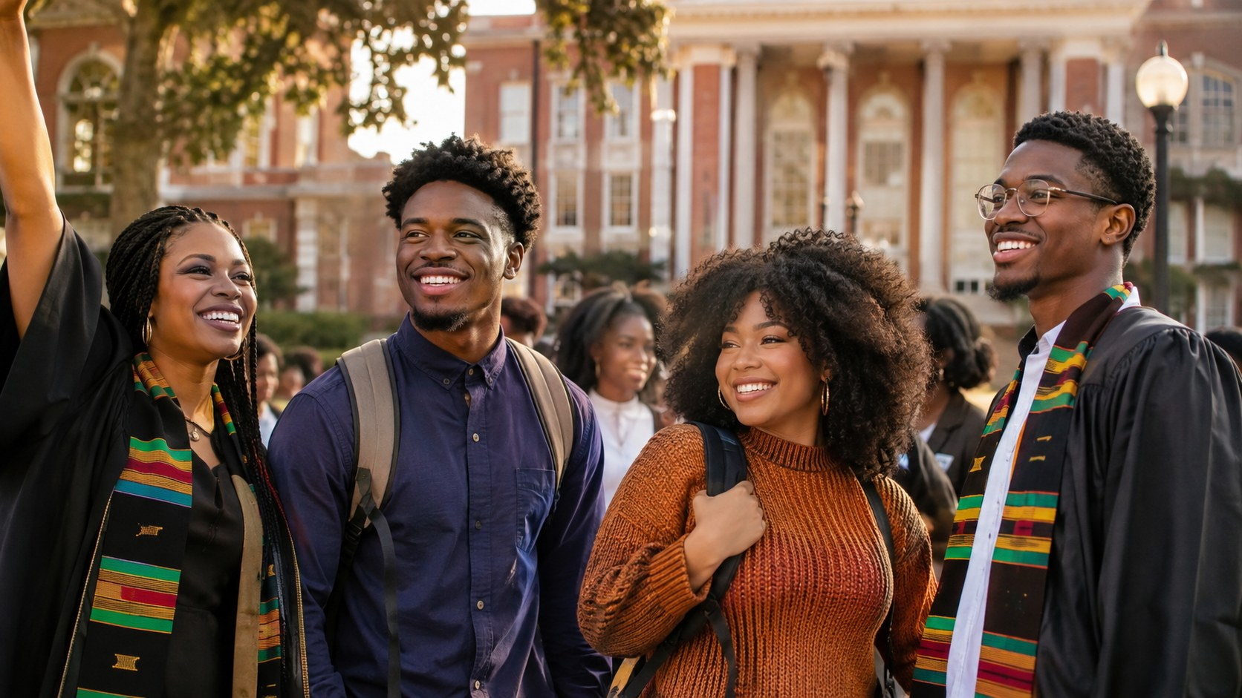
OPENING MOVE
This is not
a roll call.
It is an asset map.
Every school name in the chat represents a resource, a relationship, and a reach we can organize.
Dr. Evelyn Bethune · NHBCUAAF · August 8, 2026
Notes:
Have people type their HBCU in the chat. Name a few schools as they appear. Then pivot: Every one of those names is a person, a skill, a job lead, a grant contact, a relationship, a resource.

Slide 3
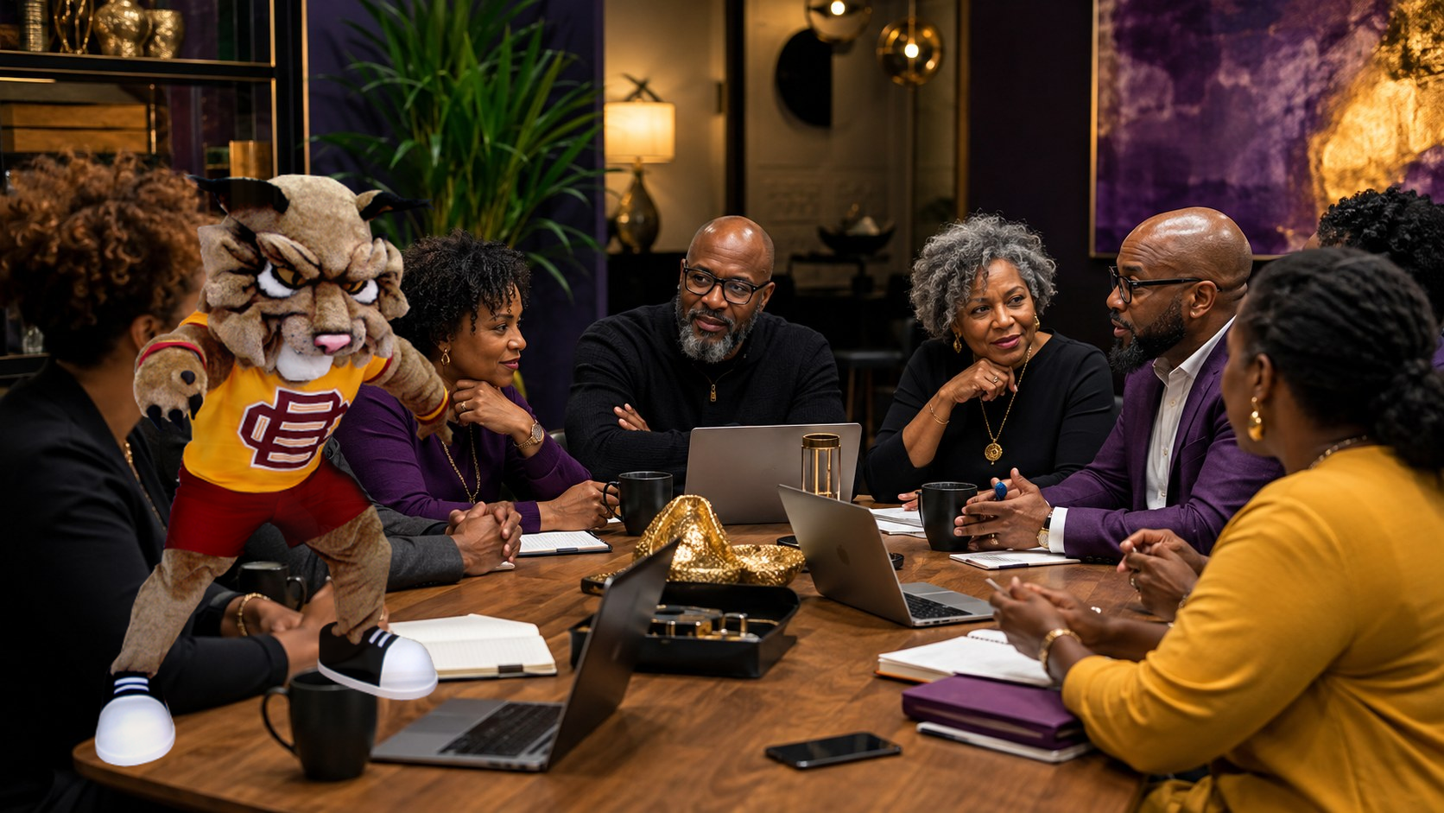
WHY I JOINED
I love one HBCU.
I joined to protect them all.
Our alumni associations cannot function only as social groups.
They must become strategic infrastructure.
Not another title. Organized power.
Dr. Evelyn Bethune · NHBCUAAF · August 8, 2026
Source: NHBCUAAF membership / about
Notes:
Say this plainly: I did not join because I love Bethune-Cookman less. I joined because loving one HBCU taught me why we must protect them all.

Slide 4
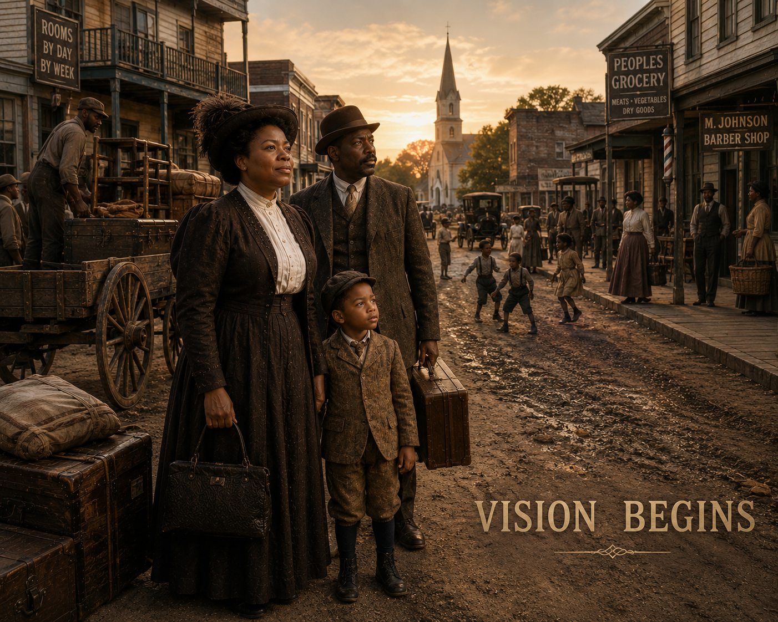
1904: FAITH BEFORE EVERYTHING WAS PERFECT
A husband.
A small child.
Five girls.
$1.50.
She was not waiting on perfect conditions. She was balancing family and purpose—trusting God for the next step.
Illustrative historical rendering
Dr. Evelyn Bethune · NHBCUAAF · August 8, 2026
Founder story: Bethune-Cookman / NPS references
Notes:
This is the Keeper story: She began with her husband, her young son—my father—five little girls, and $1.50. Make it human. A woman of faith, with family responsibility and a purpose too strong to wait.

Slide 5
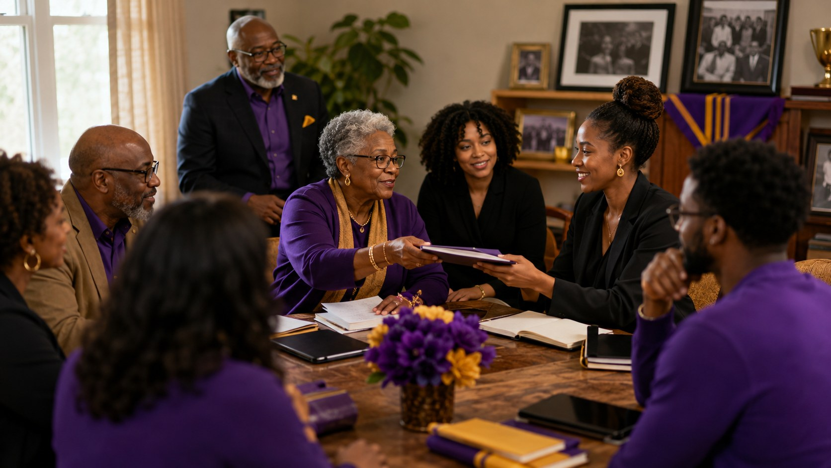
THE MODEL ALREADY WORKED
An organization
of organizations.
Dr. Bethune understood that leaders did not have to give up their own organizations to share strategy, training, and influence.
Bring strength to one table.
Then build what no single table can hold.
Dr. Evelyn Bethune · NHBCUAAF · August 8, 2026
Source: Library of Congress / NCNW history
Notes:
Make the bridge to NCNW. Say: A Delta did not have to stop being a Delta. A NAACP leader did not leave the NAACP. They brought their strength to a shared table.

Slide 6
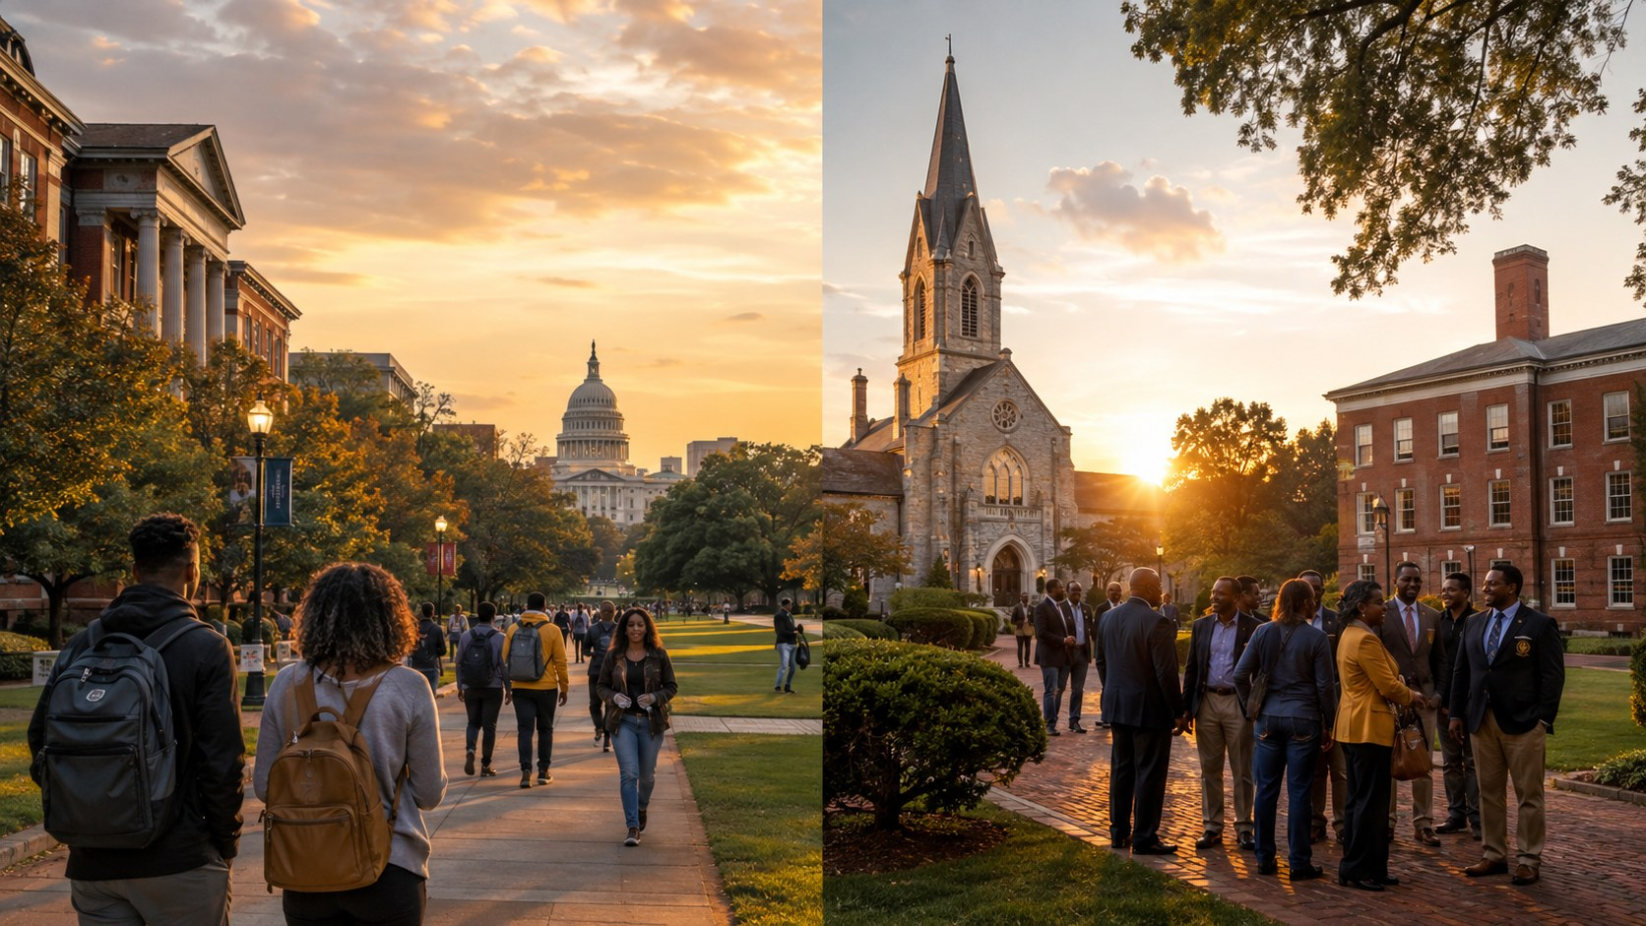
THE STATE OF THE MOMENT
When agencies shift,
HBCUs feel it.
40%
90
$504M
ED workforce reduction
reported by OIG
grants terminated
by reported actions
total obligations
reported terminated
This is not a panic point. It is a pay-attention point.
Smaller institutions need more shared intelligence when rules, grants, and oversight systems move.
Dr. Evelyn Bethune · NHBCUAAF · August 8, 2026
Source: U.S. Dept. of Education OIG, 2026
Notes:
Stay nonpartisan. Say: This is about our responsibility no matter who is in office. When federal systems shift, HBCUs need alumni who can read the room, read the rules, and help the institution navigate.

Slide 7
Public and private HBCUs need different tools — and the same commitment.
Public: state appropriations, capital funding, policy decisions.
Private: tuition pressure, grants, foundation support, giving, enrollment.
DIFFERENT PRESSURES. SHARED FUTURE.
Strategy before emergency.
Dr. Evelyn Bethune · NHBCUAAF · August 8, 2026
Sources: ED Title III-B; USDA funding-gap letter
Notes:
Make the point that public and private HBCUs may not feel the same pressure on the same day, but they are in the same ecosystem. A threat to one part weakens the whole.

Slide 8
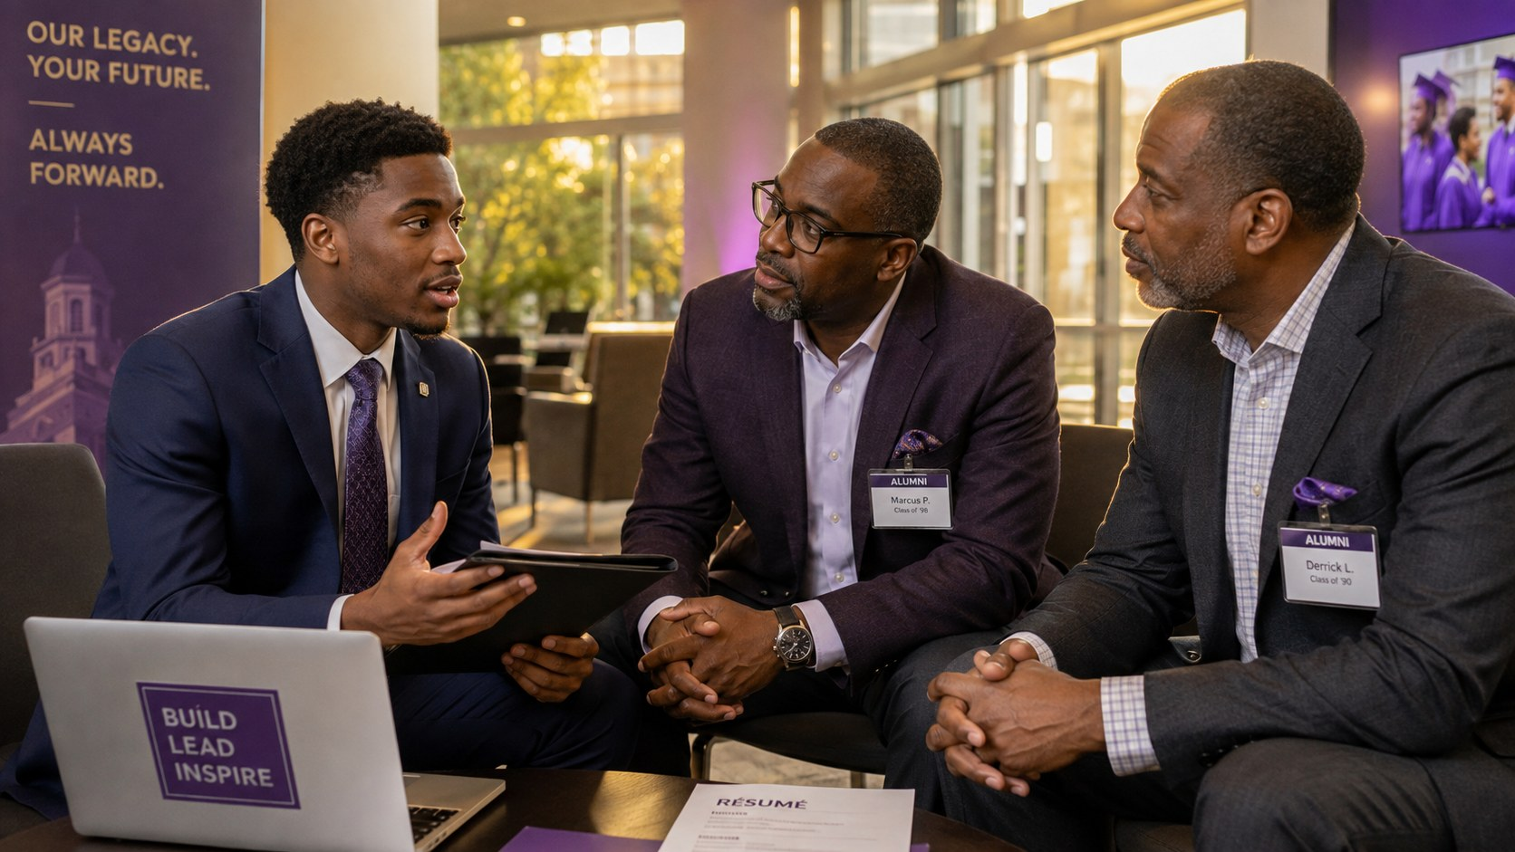
BEYOND GRADUATION
Our graduates need more than congratulations.
Be the network.
Open the door.
Explain the room.
5.6%
≈42%
unemployed
recent grads
underemployed
recent grads
Dr. Evelyn Bethune · NHBCUAAF · August 8, 2026
Source: Federal Reserve Bank of New York
Notes:
Say: It is not enough to post congratulations if we are unwilling to help students enter the rooms where we already sit. Many of us can hire, refer, mentor, place, introduce, explain.

Slide 9
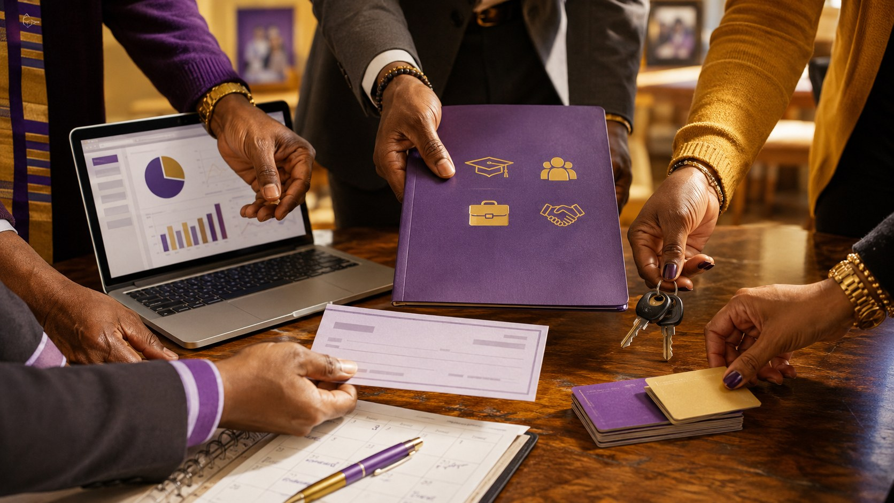
REFRAMING ALUMNI VALUE
Alumni are not
just an ATM.
We are capital.
Relationships
Contracts
Jobs
Wisdom
Policy
Dollars
Dr. Evelyn Bethune · NHBCUAAF · August 8, 2026
Notes:
This is a disruptive moment. Say: Yes, we must give. But do not reduce alumni to an ATM in school colors. We are intellectual, relationship, business, policy, and cultural capital.

Slide 10
THE ALUMNI POWER AGENDA
Five forms of
collective power
1
Shared intelligence
grant alerts · policy shifts · templates
2
Employment power
hire · refer · mentor · coach
3
Financial power
giving · endowment · vendor support
4
Advocacy power
budgets · boards · public narrative
5
Leadership succession
train younger alumni now
Dr. Evelyn Bethune · NHBCUAAF · August 8, 2026
Notes:
This is the practical framework. Keep it moving. Do not overexplain each one here. The slide is the bridge to action.

Slide 11
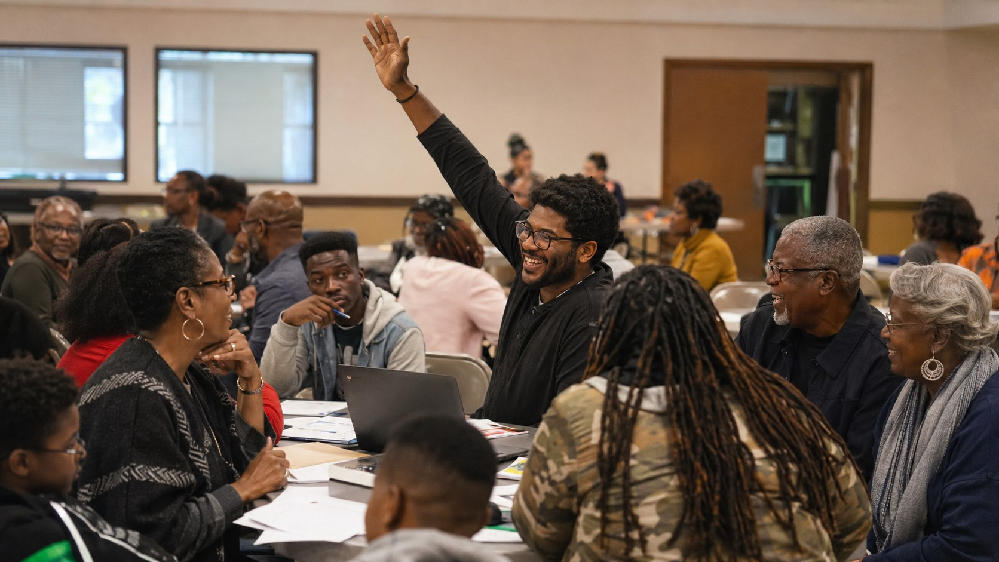
DO NOT LET THEM DISCONNECT US
Compete on the field.
Collaborate for the future.
School pride should not become information hoarding.
When one association learns, every association should have a way to learn. That is not charity. That is strategy.
Dr. Evelyn Bethune · NHBCUAAF · August 8, 2026
Notes:
This is where you can use humor: We can debate the best band and the best homecoming later. But when resources are shifting and students need us, we need cooperation.

Slide 12
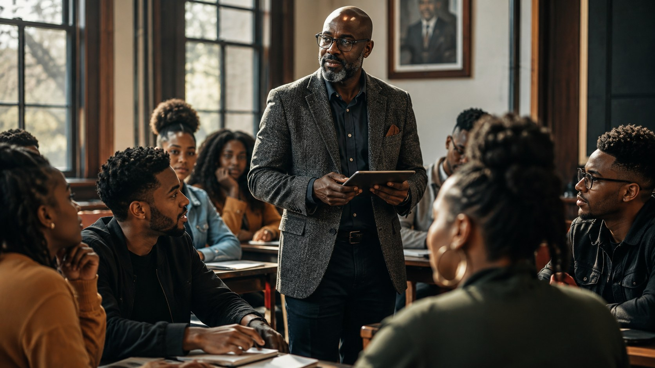
THE COLLECTIVE LEGACY COMMITMENT
Before the next conference:
Share one proven resource.
Open one employment or mentoring door.
Build one cross-HBCU partnership.
Train one emerging alumni leader.
Report one measurable result.
Move from activity to impact.
Dr. Evelyn Bethune · NHBCUAAF · August 8, 2026
Notes:
End this slide with: Not just how many meetings. What changed because your association acted? How many students, jobs, internships, dollars, partners, leaders?

Slide 13
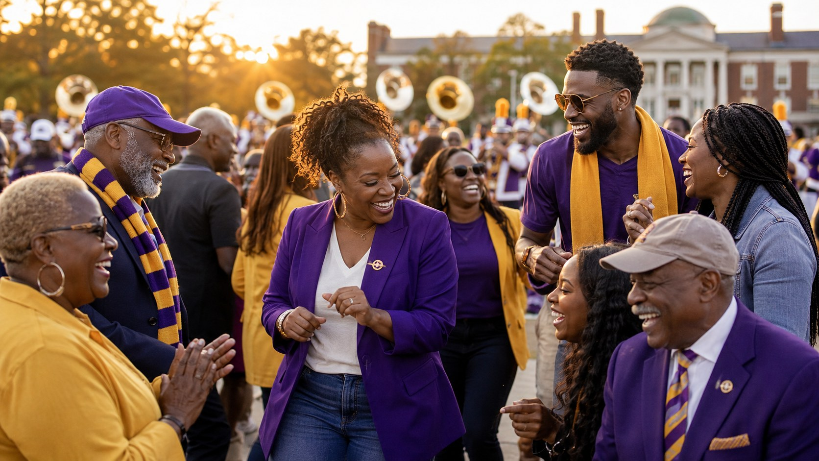
JOY IS STRATEGY TOO
We can love this work
and still have fun.
Joy keeps movements from turning into meetings with snacks.
We are not just protecting institutions. We are protecting belonging, music, memory, community, and a future our students can feel.
Dr. Evelyn Bethune · NHBCUAAF · August 8, 2026
Notes:
This slide keeps the talk from becoming heavy. Say: We do not want everything to be a battle. We are people who love our schools, our bands, our memories, our joy. Joy is part of the strategy.

Slide 14
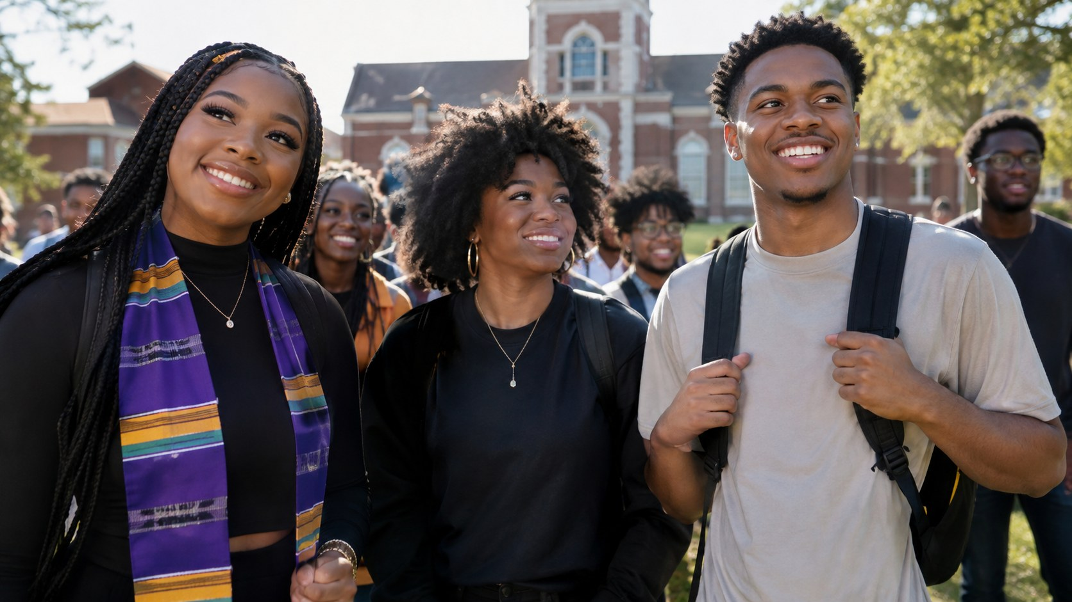
CLOSING CHARGE
Apart, we carry pride.
Together, we carry power.
Let the record show: when the ground shifted, HBCU alumni did not scatter. We organized.
We are stronger together than apart.
Continuing the Legacy · Thank You
Notes:
Final words: We must build, hire, mentor, give, advocate, organize, and work together. Then deliver the last line slowly: We are stronger together than apart.

Slide 15
PREPARATION / SOURCES
Sources & visual notes
• NHBCUAAF: 2026 conference theme; mission; membership and services pages.
• U.S. Department of Education: Title III-B / Strengthening HBCUs; FY 2025 HBCU grant investment information.
• U.S. Department of Education Office of Inspector General: Review of staffing, operations, contracts and grants, June 2026.
• U.S. Departments of Education and Agriculture / USDA: 2023 letters on land-grant HBCU funding disparity.
• Federal Reserve Bank of New York: Labor Market for Recent College Graduates interactive data.
• Mary McLeod Bethune founding story references: Bethune-Cookman University history, NPS/Library of Congress materials; Slide 4 is an illustrative rendering, not an archival photo.
• Visuals: custom AI-generated images created for this presentation in a purple/gold HBCU legacy style.
Presenter note: Keep source slide hidden if you do not want to show it during the live keynote.
Appendix · Not intended for live delivery unless requested
Notes:
This slide is for reference and transparency. You may hide it before presenting if desired.

