Slide 1


NHBCUAAF 12th Annual Alumni Leaders Conference
8 August 2026
State of the Foundation
PRESENTED BY
Robert J. Corbitt, Jr.
ORGANIZATION
Transformation Center of Excellence, LLC
CONTACT
robert@transformationcoe.com

Slide 2
NHBCUAAF: State of the Foundation
Discussion Topics:
Program Area Overview
Impact and Outcomes
Metrics
2027 Planed Activity

Slide 3
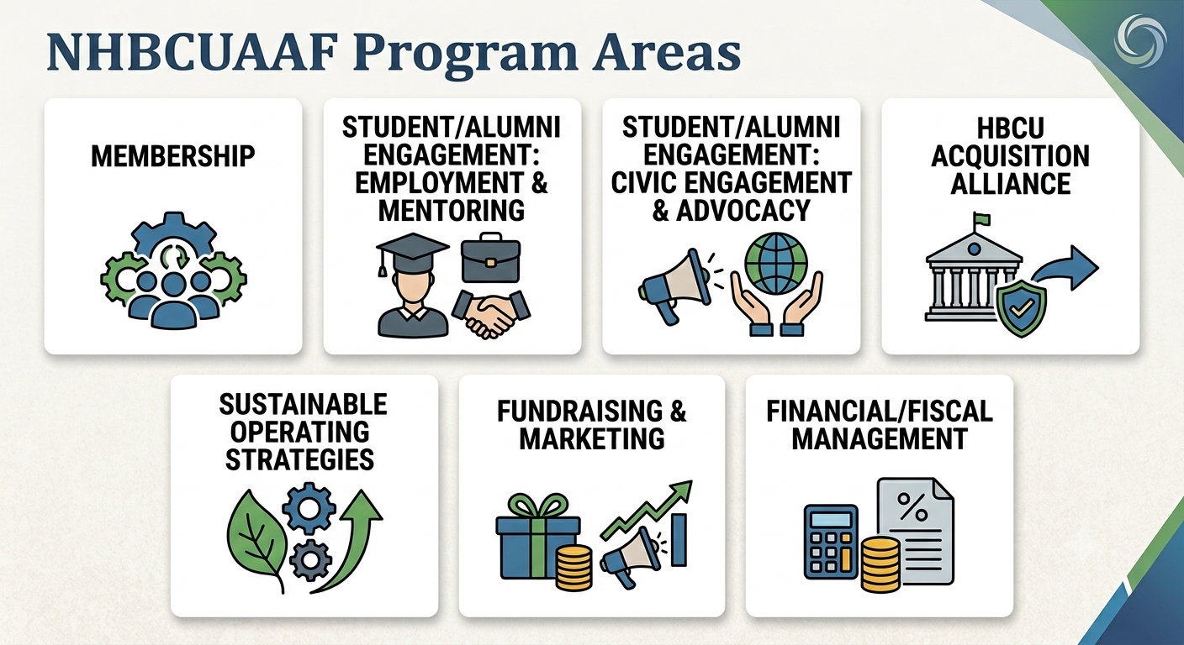
NHBCUAAF: State of the Foundation

Slide 4
NHBCUAAF: State of the Foundation
Program Area Overview
Program Area | Program Goals
Membership | 51% Association Goal
Student / Alumni Engagement: Employment & Mentoring | Right of First Refusal (RoFR) Project Student & Alumni Employment Assistance (S/AEA) Alumni Financial Literacy Training Alumni Career Development / Soft Skills Training
Student / Alumni Engagement: Civic engagement and advocacy | HBCU Student Ambassador VREM GOTV Project NCCU Civic Engagement Working Group (CEWG) Project Alumni Association CEAC activation / sustainment
HBCU acquisition alliance (AA) | Subcontract capture under federal prime contractors
Sustainable Operating Strategies (SoS) | Leadership, Governance & Compliance Training
Fundraising + Marketing | $1.0 Billon Capitol Campaign
Financial / Fiscal Management | Initiatives implemented to formalize our financial infrastructure to model best practices and ensure the highest level of confidence in our financial management process

Slide 5
NHBCUAAF: State of the Foundation
Impact and Outcomes
Program Area/Title | Program Goals by Activities | Impact | Outcomes
Membership | 51% Association Goal | Established membership levels; Ran multiple membership alerts for a discounted membership through 3/31/2026. We continue to send outreach emails to HBCU Alumni Associations. These ongoing communications, drafted by the president, include a request for associations to join NHBCUAAF. | Secured six (6) paid memberships
Student / Alumni Engagement: Employment & Mentoring | Right of First Refusal (RoFR) Project | The project combines internship supervision, partnership support, media/project development, and final deliverable production in support of fundraising, youth engagement, workforce development, media visibility, and Africa-centered opportunity. | Two (2) of the four (4) Fayetteville State University (FSU) students employed to execute task assignments under The Seven Tracks: How Students Can Train for Africa-Centered Opportunity Now framework/methodology.
 | Student & Alumni Employment Assistance - (S/AEA) | Established relationships/partnerships with industry and NGOs to secure grant investment and employment. Partnership with Sherman Williams Paint Company to provide internships/summer employment to HBCU students in the SE USA, see Internship Flyer and Press Release. | 1). Intern assignments with BPG, HTA, LSECU, SWPC SE Student employment for students attending AAMU, CAU, FSU, FSU, NCCU and SCSU and SWPC NE Student employment discussions with BFSU, NSU, UDC and WVSU. and Hibel Foundation 2). Career Development Session for CGI Federal to recruit seasoned professionals.
 | Scholarships | Established relationships/partnerships with the Renaissance Foundation to provide scholarships to HBCU students | Renaissance Foundation to provide up to 25 $4,000 per year for 4 years awards to HBCUs
 | Alumni Financial Literacy Training | Established a partnership with a training & development firm to deliver courses in financial literacy | Broadcast an offering message to all HBCU Alumni Associations announcing the offering
 | Alumni Career Development / Soft Skills Training | Established a partnership with a training & development firm to deliver courses in career development & soft skills | Broadcast an offering message to all HBCU Alumni Associations announcing the offering

Slide 6
NHBCUAAF: State of the Foundation
Impact and Outcomes
Program Area/Title | Program Goals by Activities | Impact | Outcomes
Student / Alumni Engagement: Civic engagement and advocacy | HBCU Student Ambassador VREM GOTV Project | Project funded at up to $10K per site/per year to engage NC HBCU students to register to vote and vote. The funded sites: Six HBCUs (ECSU, FSU, Livingstone College, NCA&T, NCCU, Shaw) and one Community College (Pitt County) | Activated five (5) projects funded at $10K per academic year from 2020-Present. One (1) is still active at NCCU. Activated a partnership with the TMCF Payne Social Justice Center to pursue funding and activate CEACs across the public HBCU ecosystem.
 | NCCU Civic Engagement Working Group (CEWG) Project | Established a partnership with NCCU to establish a student lead VREM GOTV Project (Collaboration between Poli Sci and Community Outreach Office). | 1). Secured $10K initial funding to launch and achieve Voter Friendly Designation at four (4) HBCUs (ECSU, FSU, NCA&T and NCCU). Each campus achieved a 90+% of student voter registration. NCCU remains active in this Project. NCCU CEWG has been active since 2020. NCCU CEWG also mentored Eastern HBCUs to achieve VFC Designation. 2). Assisted in the activation of multiple HBCU AA CEACs across NC ecosystem.
 | Civic Engagement & Advocacy Committee (CEAC) | Engagement with HBCUAAs to activate a CEAC to advocate on behalf of their Alma Mater at the local, state and national levels. | CEACs activated in six (6) NC NCCUAA Chapters and the NC HBCU Alliance.
HBCUAA | Subcontract capture under federal prime contractors | Established a partnership with Bucannon & Edwards to work with Alabama A&M University (AAMU) and secure federal contracts and/or subcontracts | 1). Secured a $50K contract for AAMU. Work continues to secure a NASA Center of Excellence Contract. 2). Working with Bucannon & Edwards to support proposal development and submission to NASA to establish an HBCU Acquisition Center of Excellence.
 |  | Partnership with Hiebel Foundation via The Planned Giving Initiative (PGI) to bring services and resources that help nonprofits expand their planned giving programs; thereby deepening the sustainability of the organization with whom they partner. | Delaware State, Howard and Norfolk State selected to participate in the Planned Giving construct.

Slide 7
NHBCUAAF: State of the Foundation
Impact and Outcomes
Program Area/Title | Program Goals by Activities | Impact | Outcomes
SOS | Leadership, Governance & Compliance Training | Established a training program to educate officers on best practices for leadership, governance and compliance. | 1). Trained officers at Arkansas Baptist College (ABC) 2). Lectured speaker for Bluefield State Alumni Association Annual Meeting 3). Held 12 consecutive Leadership Conferences to update association leaders on issues relevant to HBCUs.
 | Governance & Compliance | Formalized our financial infrastructure to model best practices and ensure the highest level of confidence in our financial management process. | 1). Hired a financial management company to advise the Treasurer on best processes and practices to ensure integrity of our financial process and ability to handle large donations. 2). Reviewed internal controls and conducted a five-year reconciliation of all financial transactions to verify recorded transactions reflect real-world activity. 3). Installed QuickBooks to automate bookkeeping, track daily cash flow, and generate accurate financial reports and tax information.
Fundraising + Marketing | Fundraising / Branding | Established multiple Affinity/Affiliate Program Offerings | Affinity/affiliate program will generate revenue to support programmatic activity
 | $1.0 Billon 5 Year Capitol Campaign | Established a Campaign framework to outline and guide activities | The Executive Director of SHRM serves as Campaign Chair, recruited numerous academic and business leaders to serve as campaign committee members.

Slide 8
NHBCUAAF: State of the Foundation
Metrics
Program Area/Title | Program Goals by Activities | Activities | Metrics
Membership | 51% Association Goal | Established membership levels; Ran multiple membership alerts for a discounted membership through 3/31/2026 | Secured six (6) paid memberships
Student / Alumni Engagement: Employment & Mentoring | Right of First Refusal (RoFR) Project | Coordinated establishment of partnership with FSU to employ up to four (4) students | Two (2) FSU student interns secured to support the RoFR Project
 | Student & Alumni Employment Assistance - (S/AEA) | Guest speaking at industry-based employment sessions; issue weekly employment opportunity alerts to students and alumni. | Metrics under development
 | Alumni Financial Literacy Training | Broadcast multiple alerts announcing the offering to all HBCU Alumni Associations announcing the offering | Awaiting feedback from recipients
 | Alumni Career Development / Soft Skills Training | Broadcast multiple alerts announcing the offering to all HBCU Alumni Associations announcing the offering | Awaiting feedback from recipients
Student / Alumni Engagement: Civic Engagement and Advocacy | HBCU Student Ambassador VREM GOTV Project | Frequent PMRs to monitor and provide technical advice & counsel | VFC Designation maintained. Awaiting transmission of the End of Year Report and Plan for Fall 2026.
 | NCCU Civic Engagement Working Group (CEWG) Project | Frequent PMRs to monitor and provide technical advice & counsel | VFC Designation maintained. Awaiting transmission of the End of Year Report and Plan for Fall 2026.

Slide 9
NHBCUAAF: State of the Foundation
Metrics (cont.)
Program Area/Title | Program Goals by Activities | Activities | Metrics
HBCU AA | Subcontract capture under federal prime contractors | Identify contract and/or grant opportunities to present | Pending feedback from prime contractors
SOS | Leadership, Governance & Compliance Training | Submitted the Patent Rights/Trade Mark | Secured Patent Rights/Trademark designation
Fundraising + Marketing | $1.0 Billon Capitol Campaign | Currently in quiet period | Identification, qualification, cultivation, solicitation and stewardship

Slide 10
NHBCUAAF: State of the Foundation
2027 Planned Activity
Integrate the findings from ‘Proof of Promise’ survey report into 2027 planning activities
Develop an organizational intelligence hub and standards repository/library
Membership: Refine membership capture and retention strategies
Student Engagement: Continue employment & mentoring
Student Engagement: Continue civic engagement and advocacy
HBCUAA: Continue prime and/or subcontract capture under federal prime contractors
Continue SOS Leadership, Governance & Compliance Training
Fundraising + Marketing: Continue $1.0 Billion Endowment Campaign
Continue to build on the foundation

Slide 11

Discussion & Questions
Thank you for your dedication to empowering HBCUs and supporting our alumni leaders.

