Slide 1
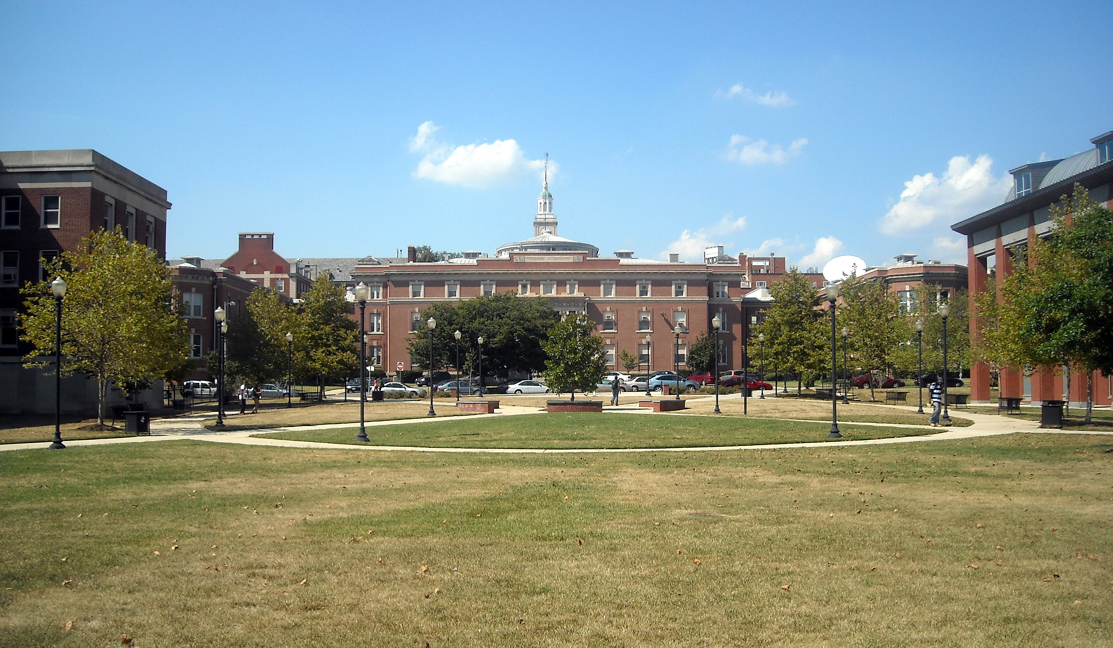

NHBCU ALUMNI ASSOCIATIONS FOUNDATION • KEYNOTE
From Counting Contributions
to Creating Impact
How HBCU Alumni Associations Focus on What Really Matters
Patricia Larkins Hicks, PhD
Founder & Principal, The Outcomes Management Group,LTD

Slide 2
THE QUESTION WE RARELY ASK
For decades, we’ve celebrated how much we gave.
Today, a different question: what did our giving make possible?
If we can’t answer that, we’re measuring generosity — not impact.
Our pride
Our giving
Our financial strain
is high
is real, but often modest
is growing — and outcomes are at risk

Slide 3
IN THE NEXT 30 MINUTES
Three things I want to connect
01
02
03
Financial Health
The Unrealized Power of Alumni
A Culture of Paying Forward
The real capacity of our schools — in numbers, not letter grades alone.
What we track today, and the leverage we’re leaving on the table.
Moving from counting contributions to creating measurable impact.

Slide 4
A QUICK GUT-CHECK
Find your school. Is it on this list?
Forbes’ 2026 Top 20 HBCUs — ranked on student outcomes, ROI, and graduation success
TOP 10 PRIVATE HBCUs
TOP 10 PUBLIC HBCUs
1. Howard University
2. Spelman College
1. North Carolina A&T State University
2. Florida A&M University (FAMU)
3. Morehouse College
4. Xavier University of Louisiana
3. Prairie View A&M University
4. Morgan State University
5. Hampton University
6. Tuskegee University
5. University of the Virgin Islands
6. Tennessee State University
7. Fisk University
8. Talladega College
7. Bowie State University
8. Winston-Salem State University
9. Clark Atlanta University
10. Tougaloo College
9. Elizabeth City State University
10. Delaware State University
Source: HBCU Game Day | Forbes

Slide 5
A NECESSARY CAUTION
Being on that list is not the same as being safe.
Forbes publishes two very different rankings — and they measure completely different things.
WHAT WE JUST SAW
WHAT COMES NEXT
Top 20 HBCUs (Outcomes)
College Financial Grades
Measures student ROI, alumni earnings, graduation & retention rates, and Pell student success.
Measures institutional liquidity — does the school have the cash reserves to survive a shock?
A school can set its graduates up for success and still be one enrollment dip away from a very hard decision. Both things are true at once. That’s why financial health deserves its own conversation.

Slide 6
FINANCIAL HEALTH, IN PLAIN NUMBERS — 1 OF 3
The grades behind the pride
26 of 35
13 of 35
private HBCUs graded C or worse on Forbes’ 2026 College Financial Grades
graded D — the lowest financial grade Forbes assigns
What this means: Most schools have limited room for error.
Source: JBHE | HBCU Game Day | Forbes

Slide 7
FINANCIAL HEALTH, IN PLAIN NUMBERS — 2 OF 3
Who these schools serve
Share of HBCU undergraduates relying on federal aid, 2019–20
81.4%
67.9%
64.3%
received federal Title IV aid
received a Pell Grant
received a federal student loan
vs. 54.9% of all U.S. students
vs. 40.2% of all U.S. students
vs. 34.5% of all U.S. students
What this means: The students being served have high financial need.
Source: PNPI

Slide 8
FINANCIAL HEALTH, IN PLAIN NUMBERS — 3 OF 3
Thin cash, aging campuses
$15K
$96M
average HBCU endowment per student — vs. $410,000 at comparable non-HBCUs
average deferred-maintenance backlog at public HBCUs — up 43% since 2018
What this means: Institutional fragility can directly weaken student outcomes.
Source: UNCF | TMCF | GAO | PNPI

Slide 9
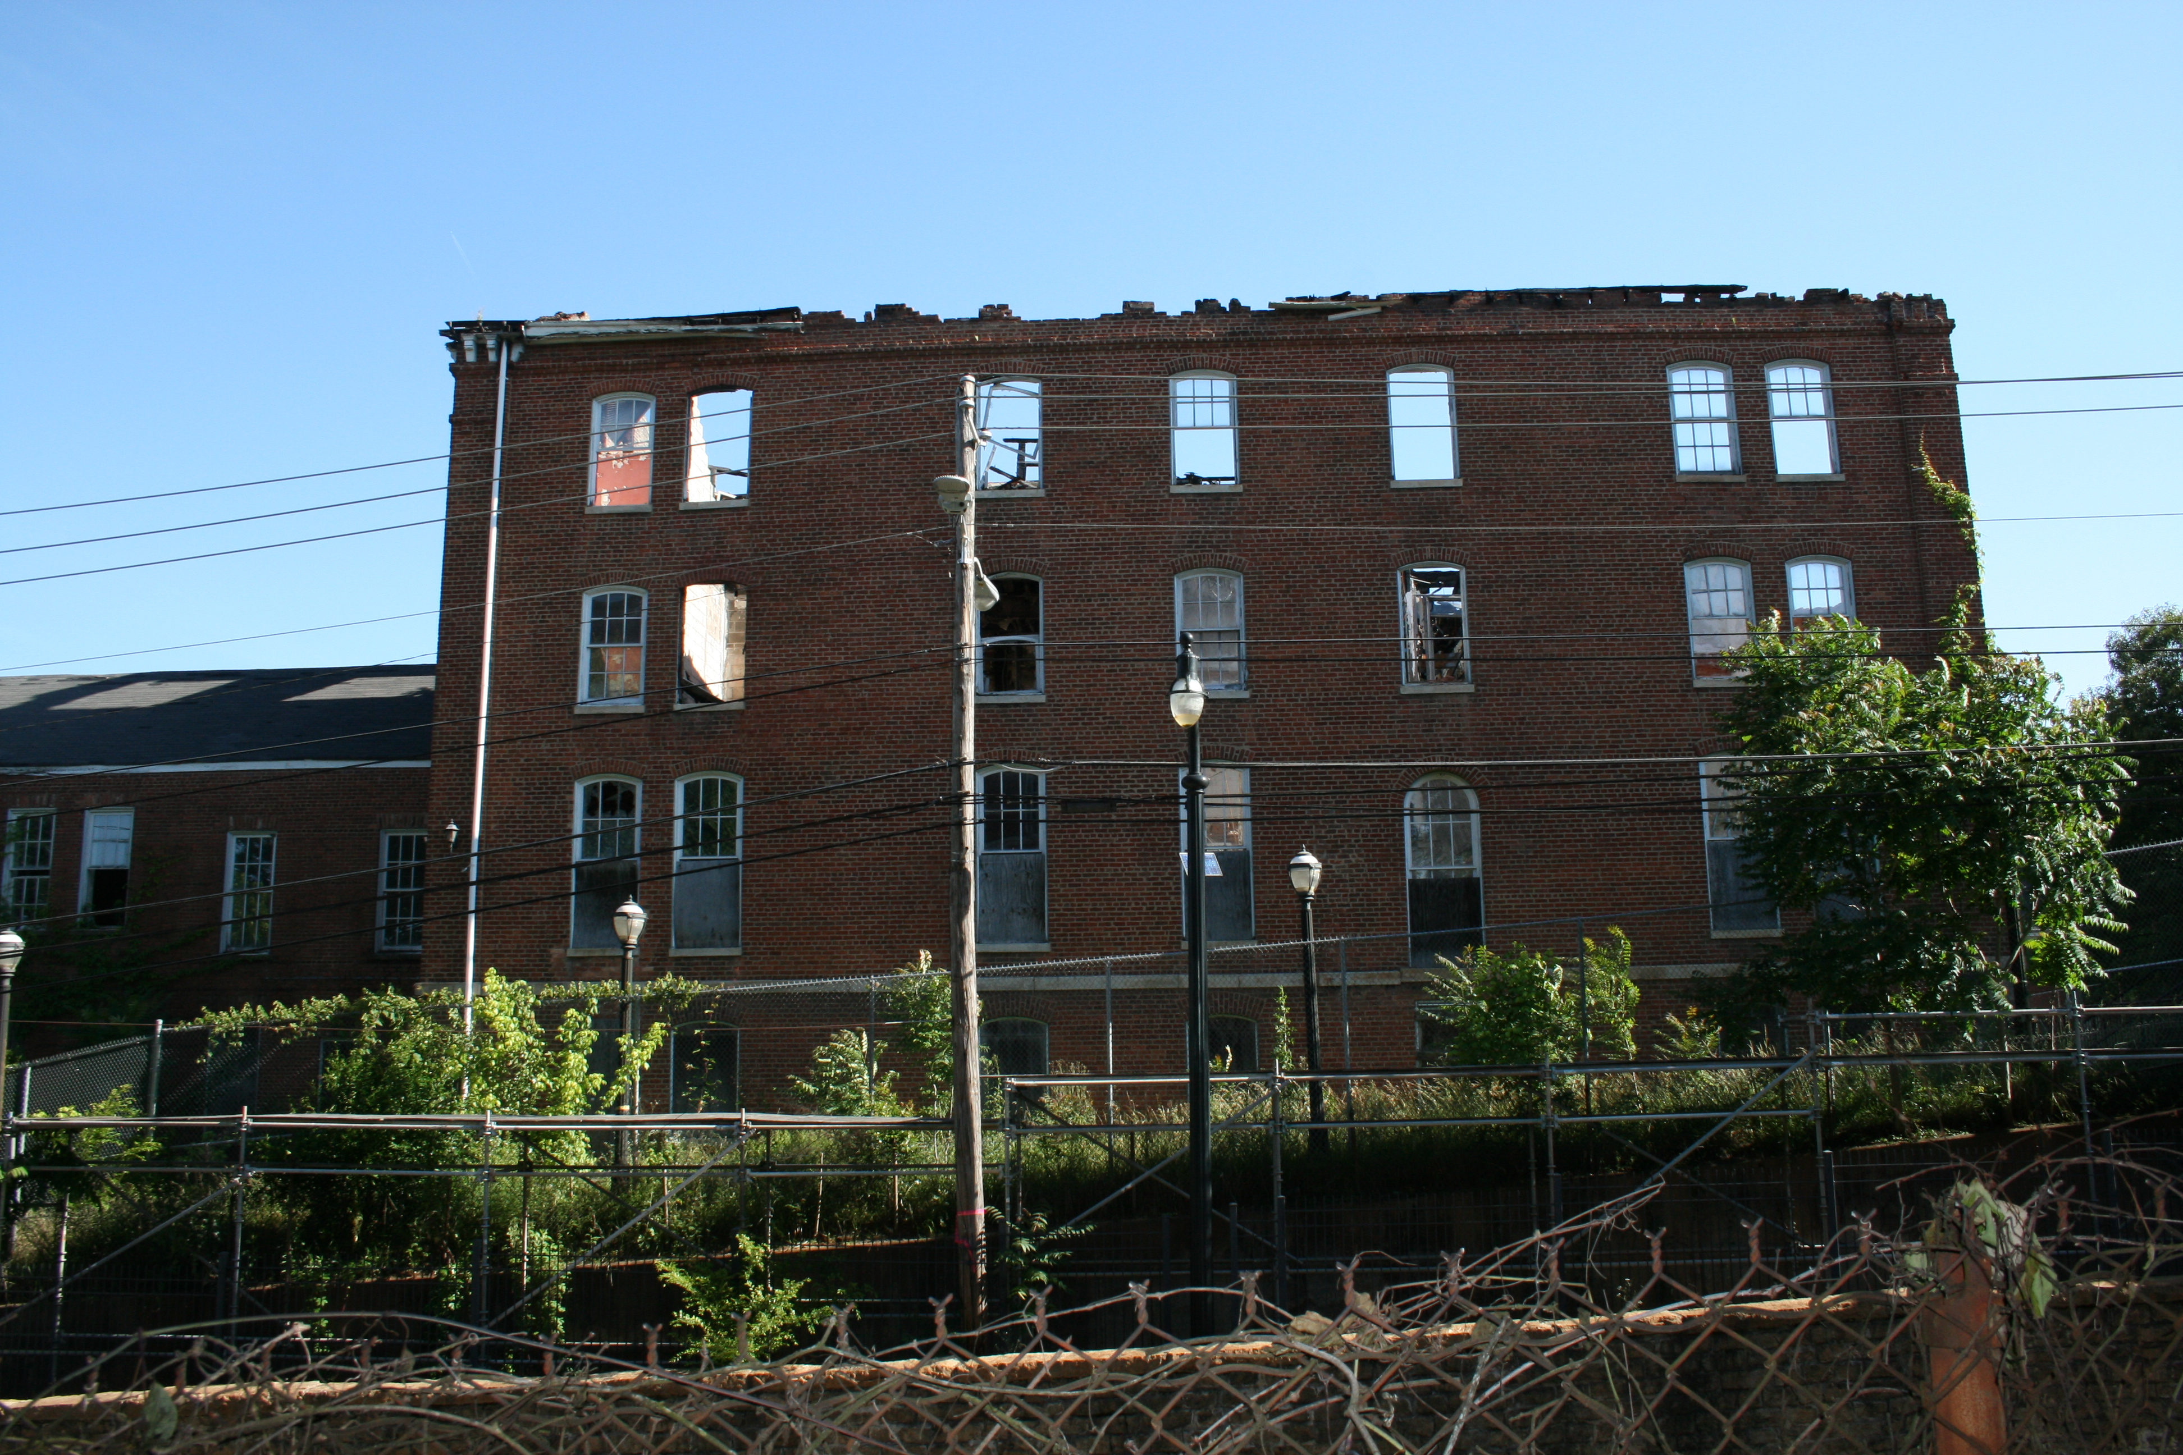
THIS ISN’T THEORY
What underfunding looks like on the ground.
Gaines Hall, one of the oldest buildings on the original Atlanta University Center campus, sat vacant after fire damage and years of deferred maintenance finished what neglect had started.
Some of the campuses we love are living one enrollment dip — or one crisis — away from very hard decisions.
Source: Atlanta Urbanize | Atlanta Journal-Constitution

Slide 10
“
Celebrating the band, the classic, and homecoming without confronting financial health is like applauding the performance while ignoring whether the stage will still be standing next year.

Slide 11
A SCORECARD PROBLEM
Counting raindrops in a drought
When financial strain runs across every grade band — not just the lowest — dollars raised alone don’t tell the whole story.
WHAT WE USUALLY TRACK
WHAT WE SHOULD ASK
– Total dollars raised
– Did we refill the reservoir?
– Number of donors
– Did we protect the campus?
– Participation percentage
– Did we change student outcomes?
– Events held
– Did we improve institutional resilience?
Source: TIAA Institute

Slide 12
THE UNREALIZED POWER OF ALUMNI
Loyal, but under-leveraged
5%
95%
$270–$51,700
HBCU alumni donor participation rate in 2023 — down from 6.3% in 2014
of HBCU endowment funds are earmarked for direct student aid — more than double the 40% national average
range in philanthropic support received per student across HBCUs — resources vary widely
When alumni do give, it is remarkably well-targeted. The opportunity is in raising how many of us give — and how strategically.
Source: TIAA Institute / CASE

Slide 13
BEYOND THE CHECK
What our current scorecard misses entirely
If we only measure checks, we ignore the full power of alumni as employers, decision-makers, and influencers.
Internships created
Jobs brokered
Contracts secured
Tech tools brought in
Partnerships formed
Endowed scholarships
We are under-counting our impact — and under-leveraging our position.

Slide 14
FROM COUNTING TO CREATING IMPACT
A framework for what “impact” actually means
01
02
03
04
Financial Resilience
Student Success
Career Outcomes
Institutional Capacity
Growth in endowment and reserves; unrestricted funds that improve a school’s financial grade.
Students retained and graduated because of scholarships, mentoring, and emergency aid.
Internships, job placements, and promotions tied directly to alumni networks.
Tech tools, partnerships, and programs that modernize and strengthen the institution.
50 alumni × $1,000 = a $50,000 endowed fund — forever, not just once.

Slide 15
A PRACTICAL NEXT STEP
Proposing a new alumni scorecard
Dollars raised, plus:
1
Students funded — scholarships and completion grants
2
Internships and jobs obtained via alumni networks
3
Partnerships or tech resources secured for the institution
4
Movement in financial resilience — endowment, reserves, or grade improvement over time
This points toward practical change — without turning giving day into a workshop.

Slide 16
A CULTURE SHIFT
Paying forward
“You can seldom pay back. But you can always pay forward — line for line, deed for deed, cent for cent.”
— Woody Hayes, Ohio State commencement address, March 14, 1986
We can’t pay back the founders, the faculty, and the elders who carried these schools through segregation and scarcity. They’re gone. But we can pay forward — to the next generation of students, and to the institutions that shaped us.
Source: Eleven Warriors

Slide 17
THREE COMMITMENTS
Let’s make this our alumni culture
1
2
3
Think impact first
Leverage our positions, not just our pockets
Make paying forward our culture
Every time we give or volunteer: what outcome will this create — for students, for the institution?
We bring internships, contracts, technology, and partnerships to the table — not only checks.
We celebrate degrees completed, careers launched, and campuses strengthened as our true measure of success.
If all we ever do is count what we gave, we will never know if we saved a campus, changed a student’s life, or closed a gap. But if we choose to pay forward — line for line, deed for deed, cent for cent — we can move HBCUs from surviving on generosity to thriving on impact.

